Slide 1
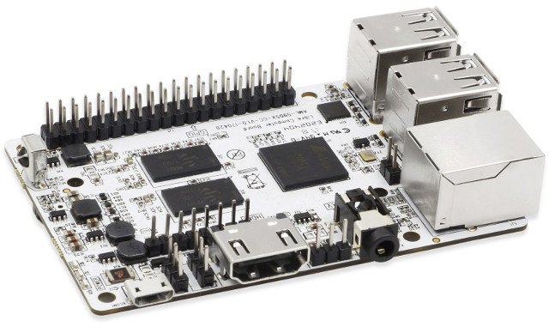
Libre Computer Board
An introduction to the Libre Computer Board
(A Raspberry Pi alternative)
Michiel Bontenbal – January 2023 – version 0.1

Slide 2
Why Libre Computer?
In (higher) education, physical computing is a practical and growing method of teaching Computer Science.
Since the introduction of Arduino ( ) and Raspberry Pi (201?) students the world over have used these small devices.
Mainly because of the world wide chip shortage, Raspberry Pi’s are currently (2022/23) very hard to get. That’s why alternatives like Libre have now become more mainstream.

Slide 3
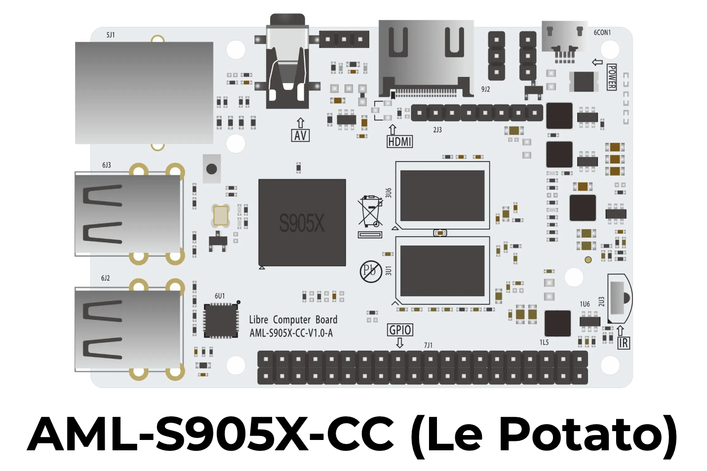
Our choice: Libre AML-S905X-CC (‘Le Potato’)

Slide 4
Product Features
Form Factor Compatible with Raspberry Pi® 2/3 Model B/B+
Quad 64-bit Low Power Cores
4 ARM Cortex-A53 @ 1.512GHz
Penta Core 3D GPU with OpenGL ES 2.0
Amlogic Video Engine (AVE10)
HDMI 2.0 with 4K HDR support
Up to 2GB DDR3
4 USB 2.0 Type A
100 Mb Fast Ethernet
3.5mm TRRS AV Jack
MicroUSB Power In
MicroSD Card Slot
eMMC Interface
IR Receiver (infrared)

Slide 5
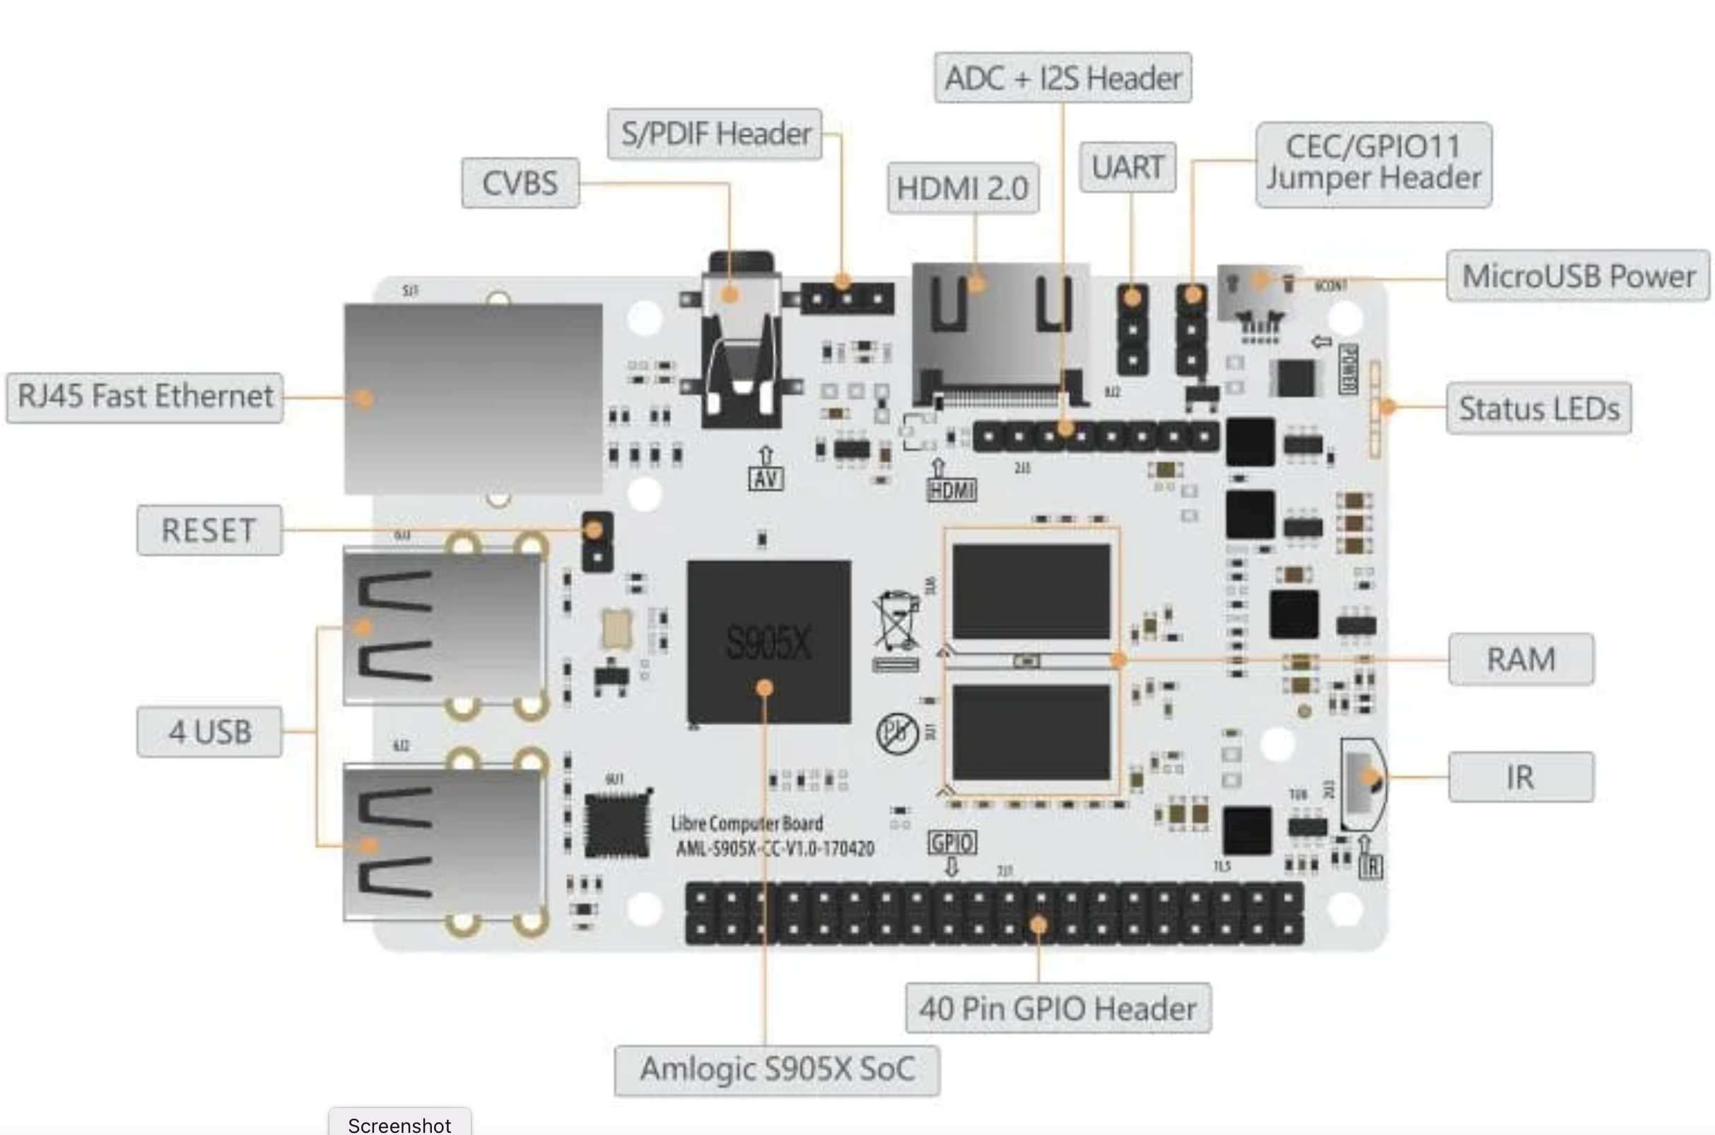
Features

Slide 6
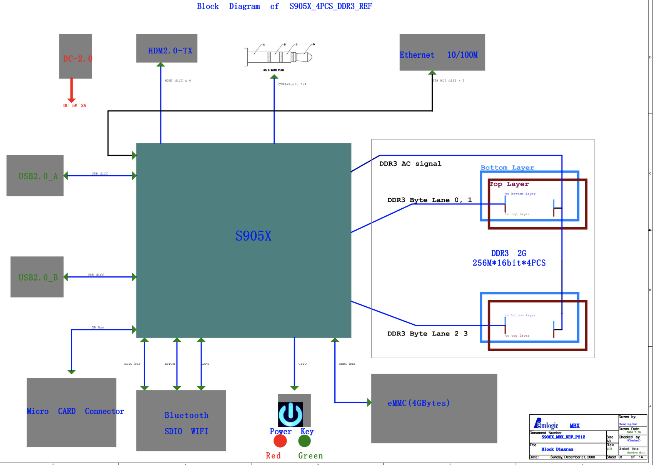

Slide 7
Getting started
What you’ll need:
MicroSD

Slide 8
ARM architecture

Slide 10
Annexes

Slide 11
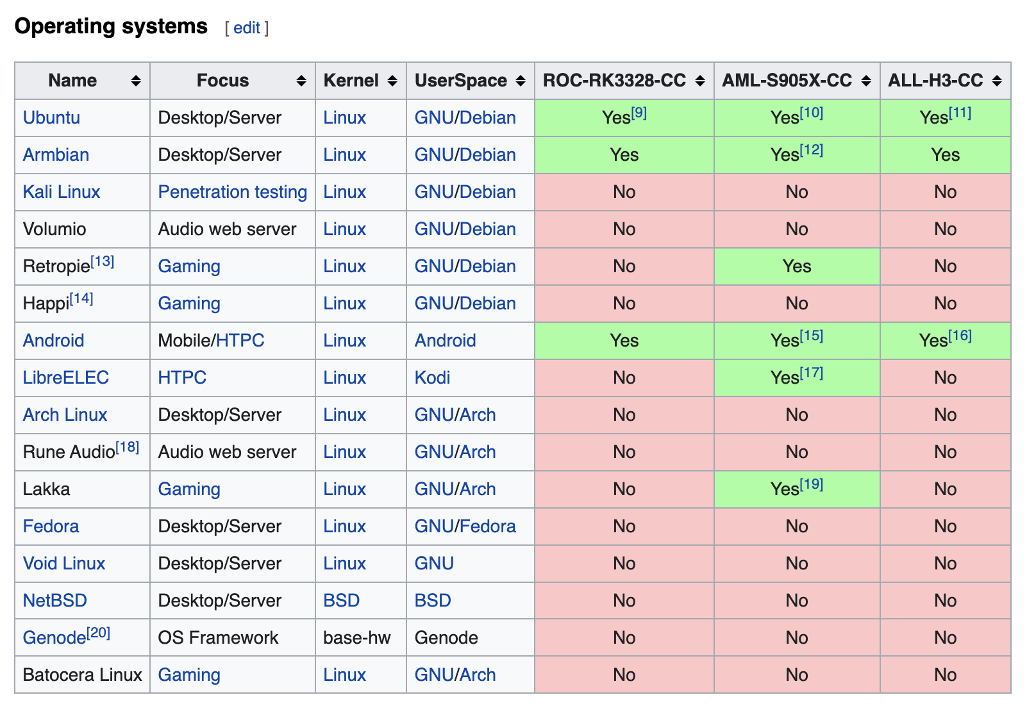
Annex 1: Libre supports various Linux distro’s including Android.

Slide 12
Sources
https://libre.computer/products/aml-s905x-cc/
https://en.wikipedia.org/wiki/Libre_Computer_Project

